Slide 1
The Easy, the Hard and the Ugly
Kenneth Church
Northeastern University
San Jose, CA, USA
Notes:
演讲题目 / Speech Topic
字体/font：方正兰亭黑简体(加粗) / Founder Lanting black(bold)
字号/font size：36
嘉宾姓名 / Name：
字体/font：方正兰亭黑简体(加粗) / Founder Lanting black(bold)
字号/font size：32
嘉宾单位&嘉宾职务 / Title and Organization
字体/font：方正兰亭黑简体(加粗) / Founder Lanting black(bold)
字号/font size：32

Slide 2
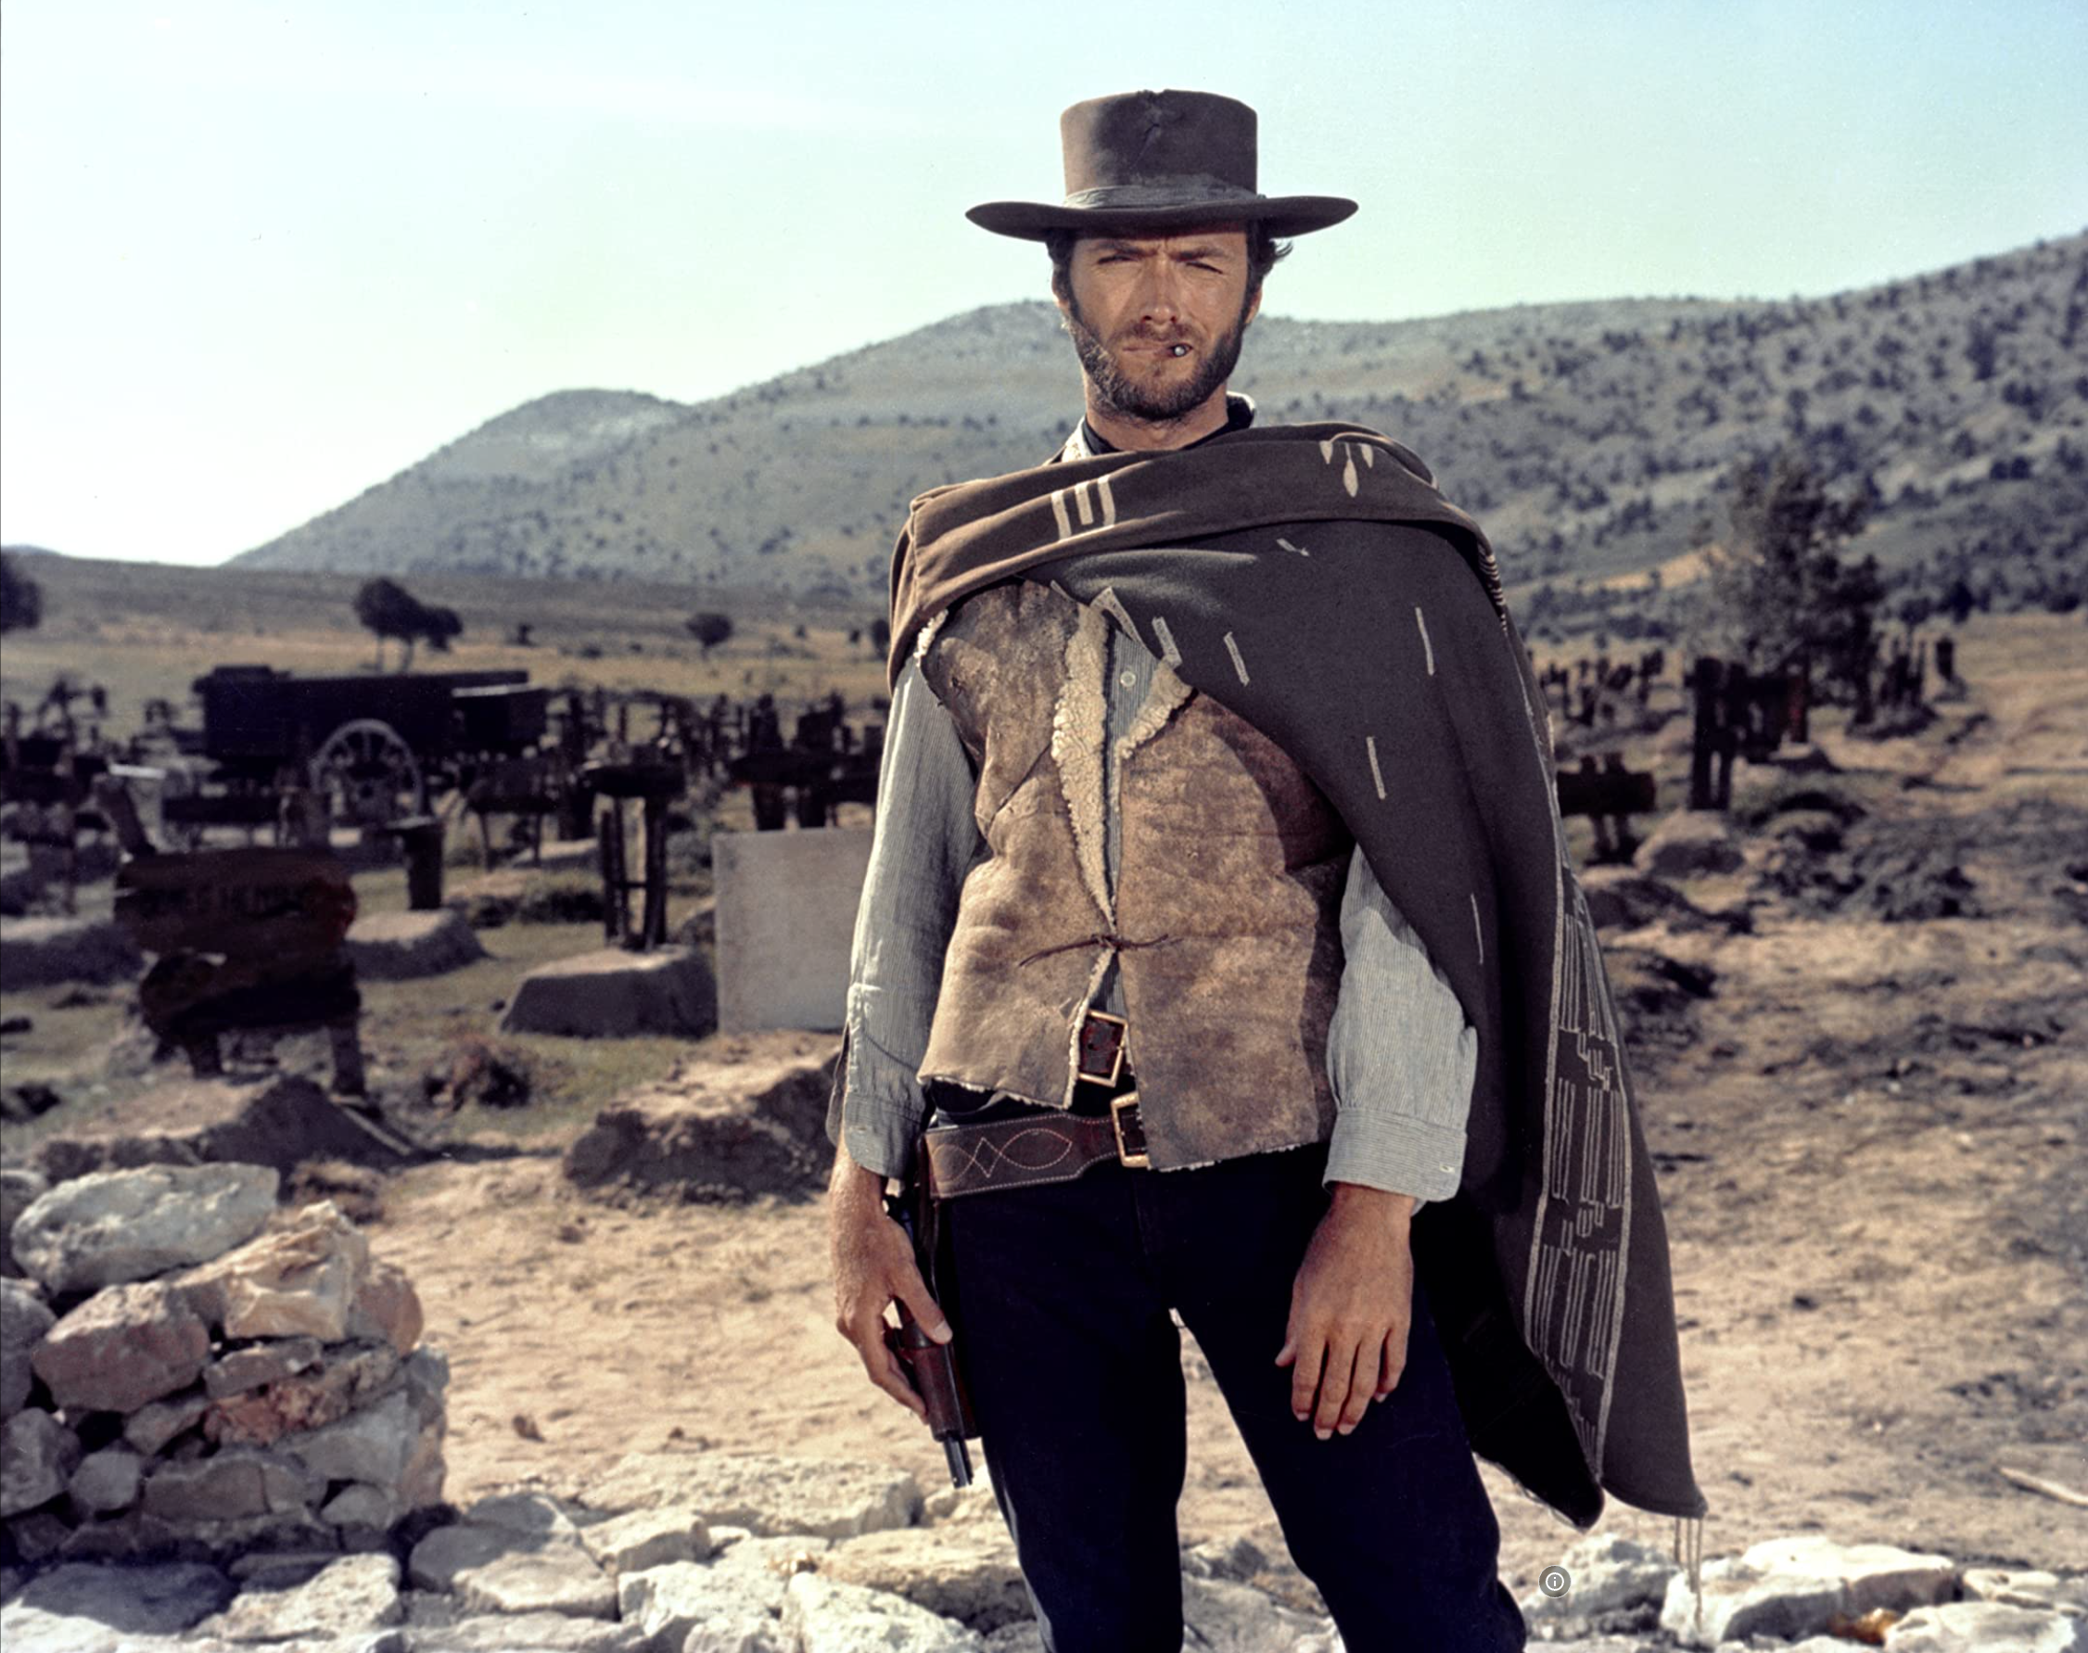

Easy: Exciting Eco-system
Prompting, Inference, Fine-Tuning
Hard: Limited to large companies
Pre-training
Ugly: Responsible AI
Bias, Toxicity
Misinformation
Hallucinations
Plagiarism

Slide 3
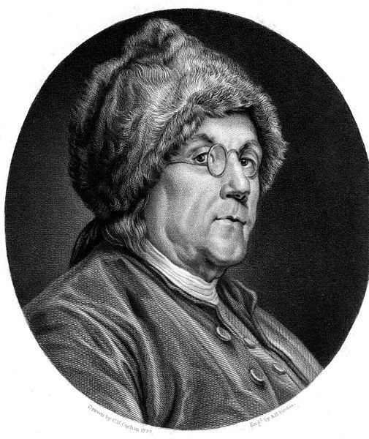
View from America
Asia: Optimism
Europe: Caution
Americans move fast
and break things
Technology → Change
(for better and for worse)

Slide 4
Prompt Engineering
Super-Popular (100+ million users)
Most successful (rapid) adoption of any web app ever
Super-Easy
Easier than Fine-Tuning (and Inference)
Use Cases
“Helping” with homework:
Cheating (?)
Documentation:
Alternative to stack overflow

Slide 5
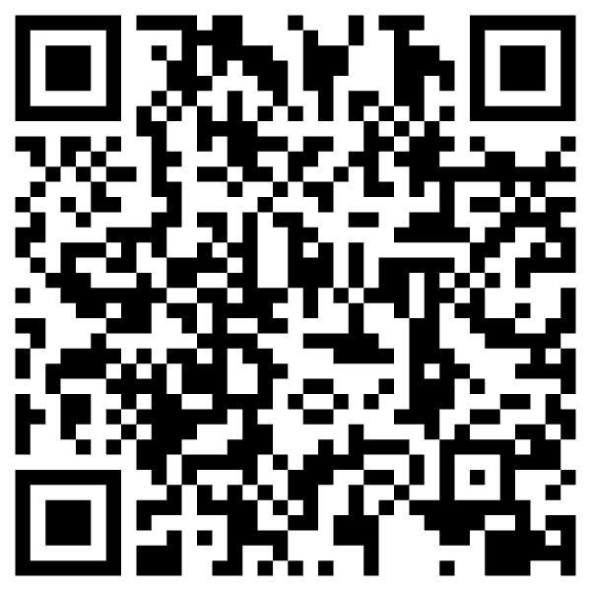
“Helping” with homework: Cheating (?)
Collaborate with students on essays
You have no idea how much we’re using ChatGPT
Cheating?
ChatGPT is better for some tasks
Good: thesis statements, outlines
Bad: capture student’s voice
Worse: quotes
Learning opportunity:
How to decompose writing to subtasks
Collaboration is great,
but student is responsible for end-product

Slide 6
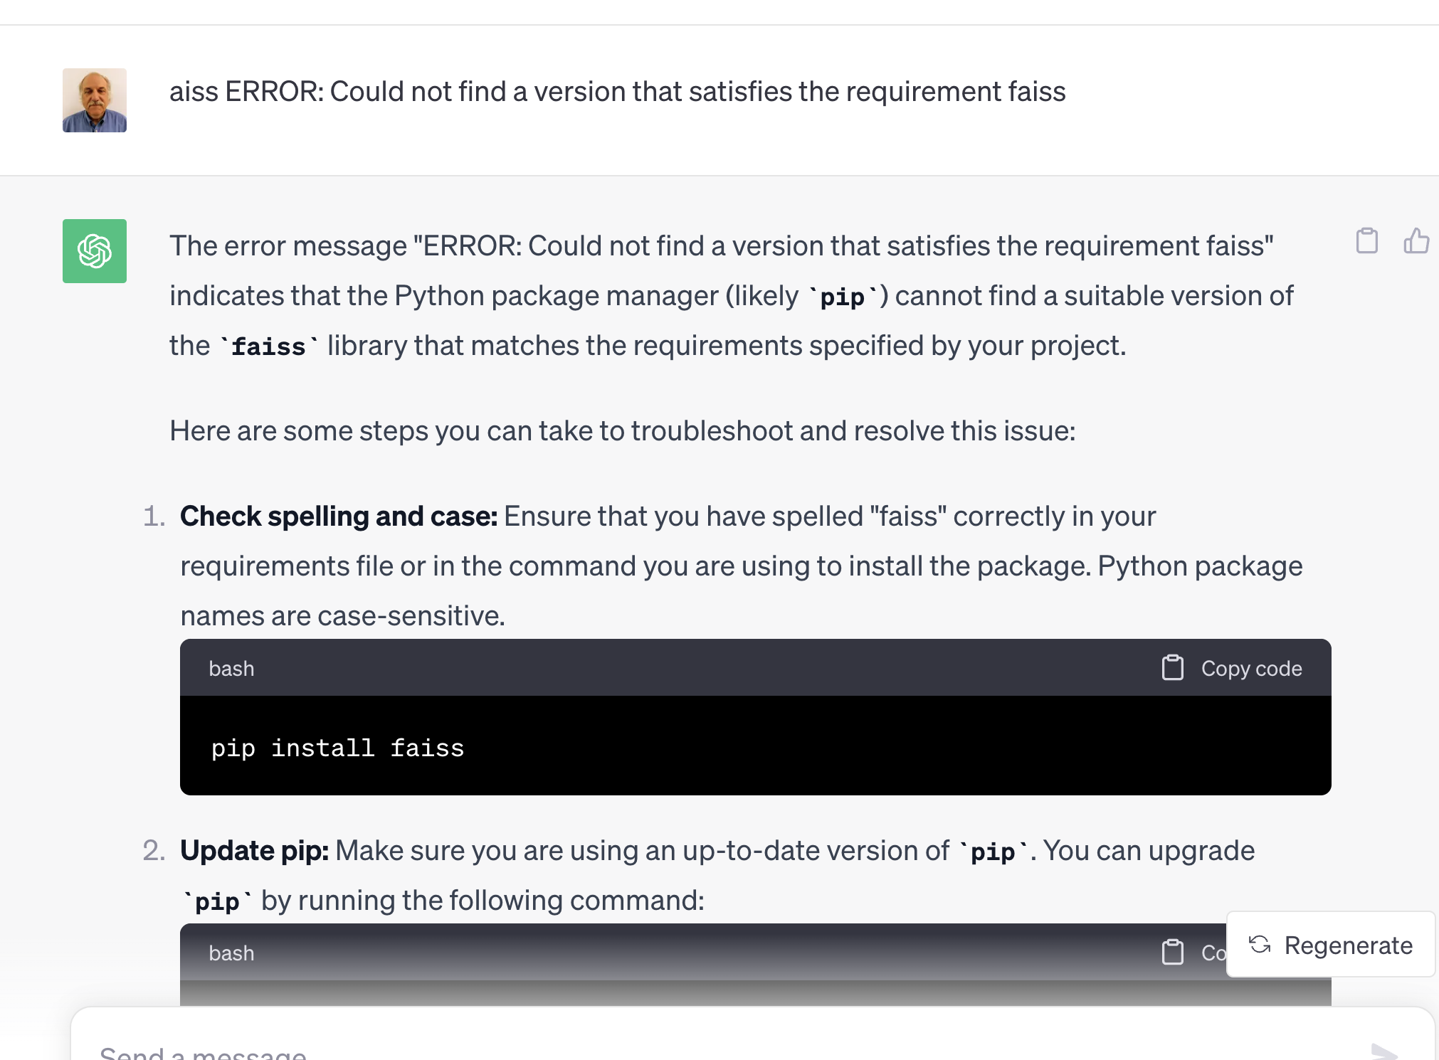
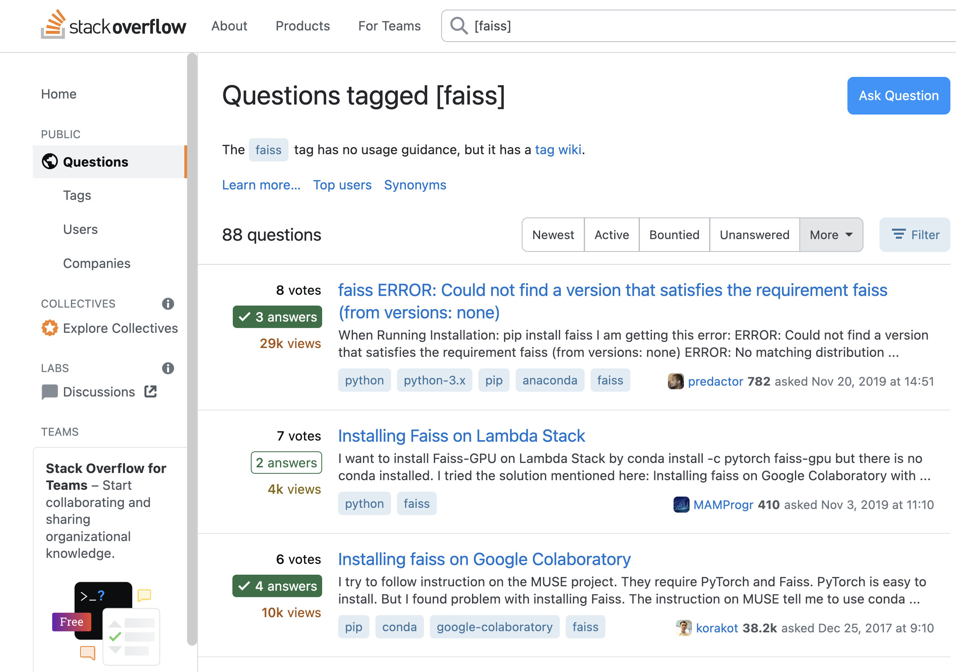
Replacing Stackoverflow with ChatGPT

Slide 7
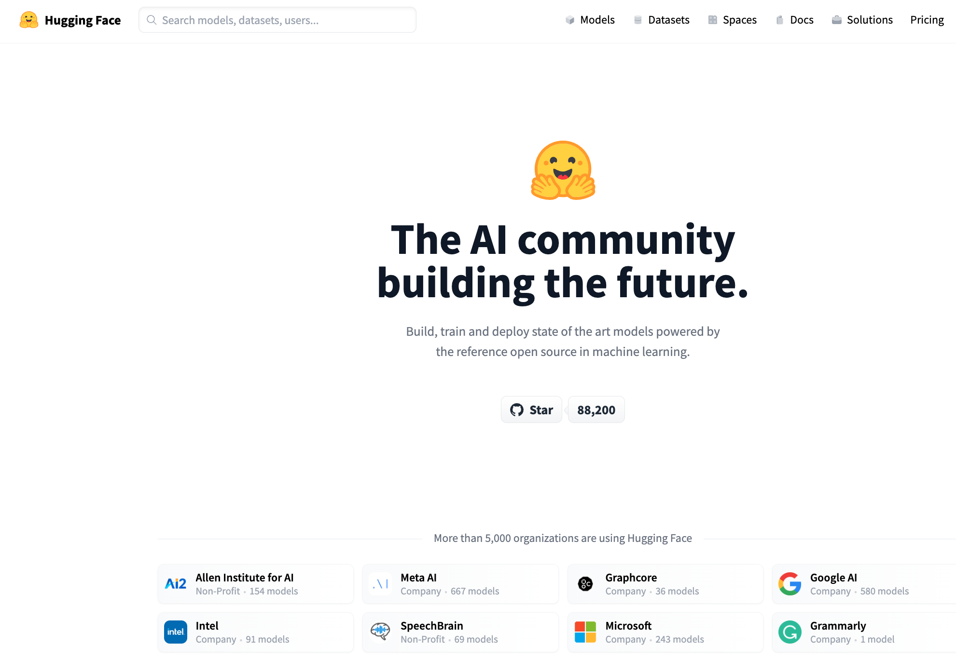

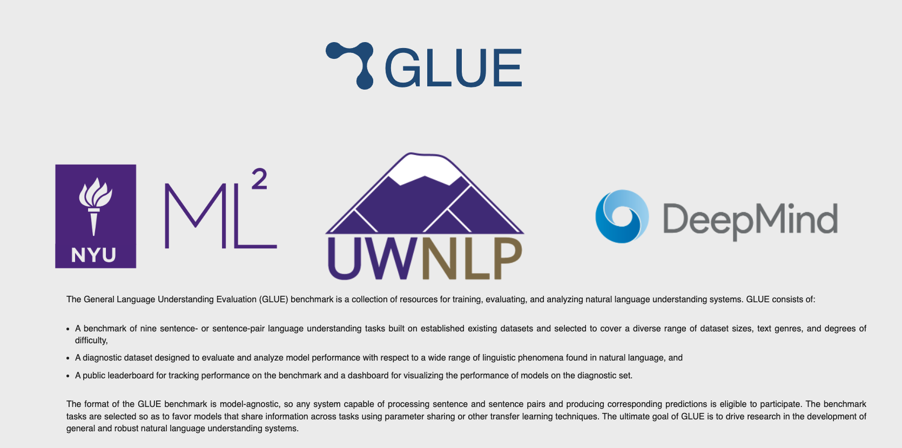
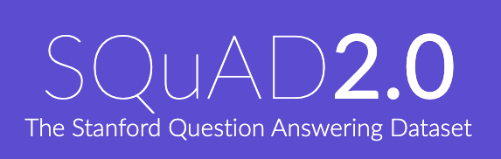
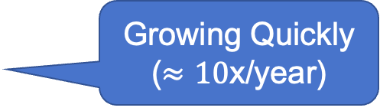
Resources
DataSets (Benchmarks)
Hubs
Examples
GLUE (NYU)
SQuAD (Stanford)
Features
Splits:
Test, Validation (Dev), Train
Metrics
Leaderboard
Examples
HuggingFace https://huggingface.co/
PaddleHub (Baidu)
Features
Datasets (50k)
Models (300k)
Apps (100k)
Community Engagement
(Social Media)
Growing Quickly
($≈10$x/year)

Slide 8
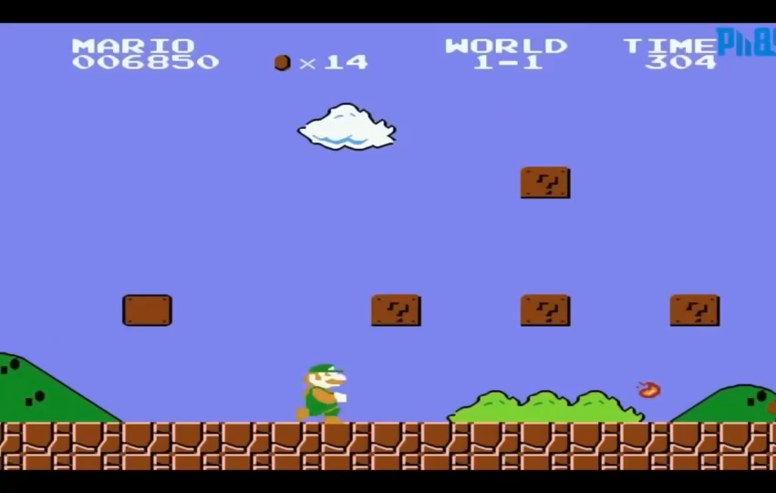
Test of time: Inference is cool (for now)
https://youtu.be/rLl9XBg7wSs

Slide 9
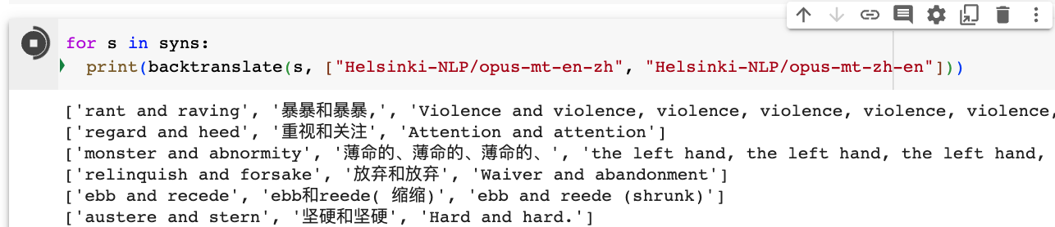
Back Translation of Synonyms

Slide 10
Easy: Exciting Eco-system
Prompting, Inference, Fine-Tuning
Hard: Limited to large companies
Pre-training
Ugly: Responsible AI
Bias, Toxicity
Misinformation
Hallucinations
Plagiarism

Slide 11
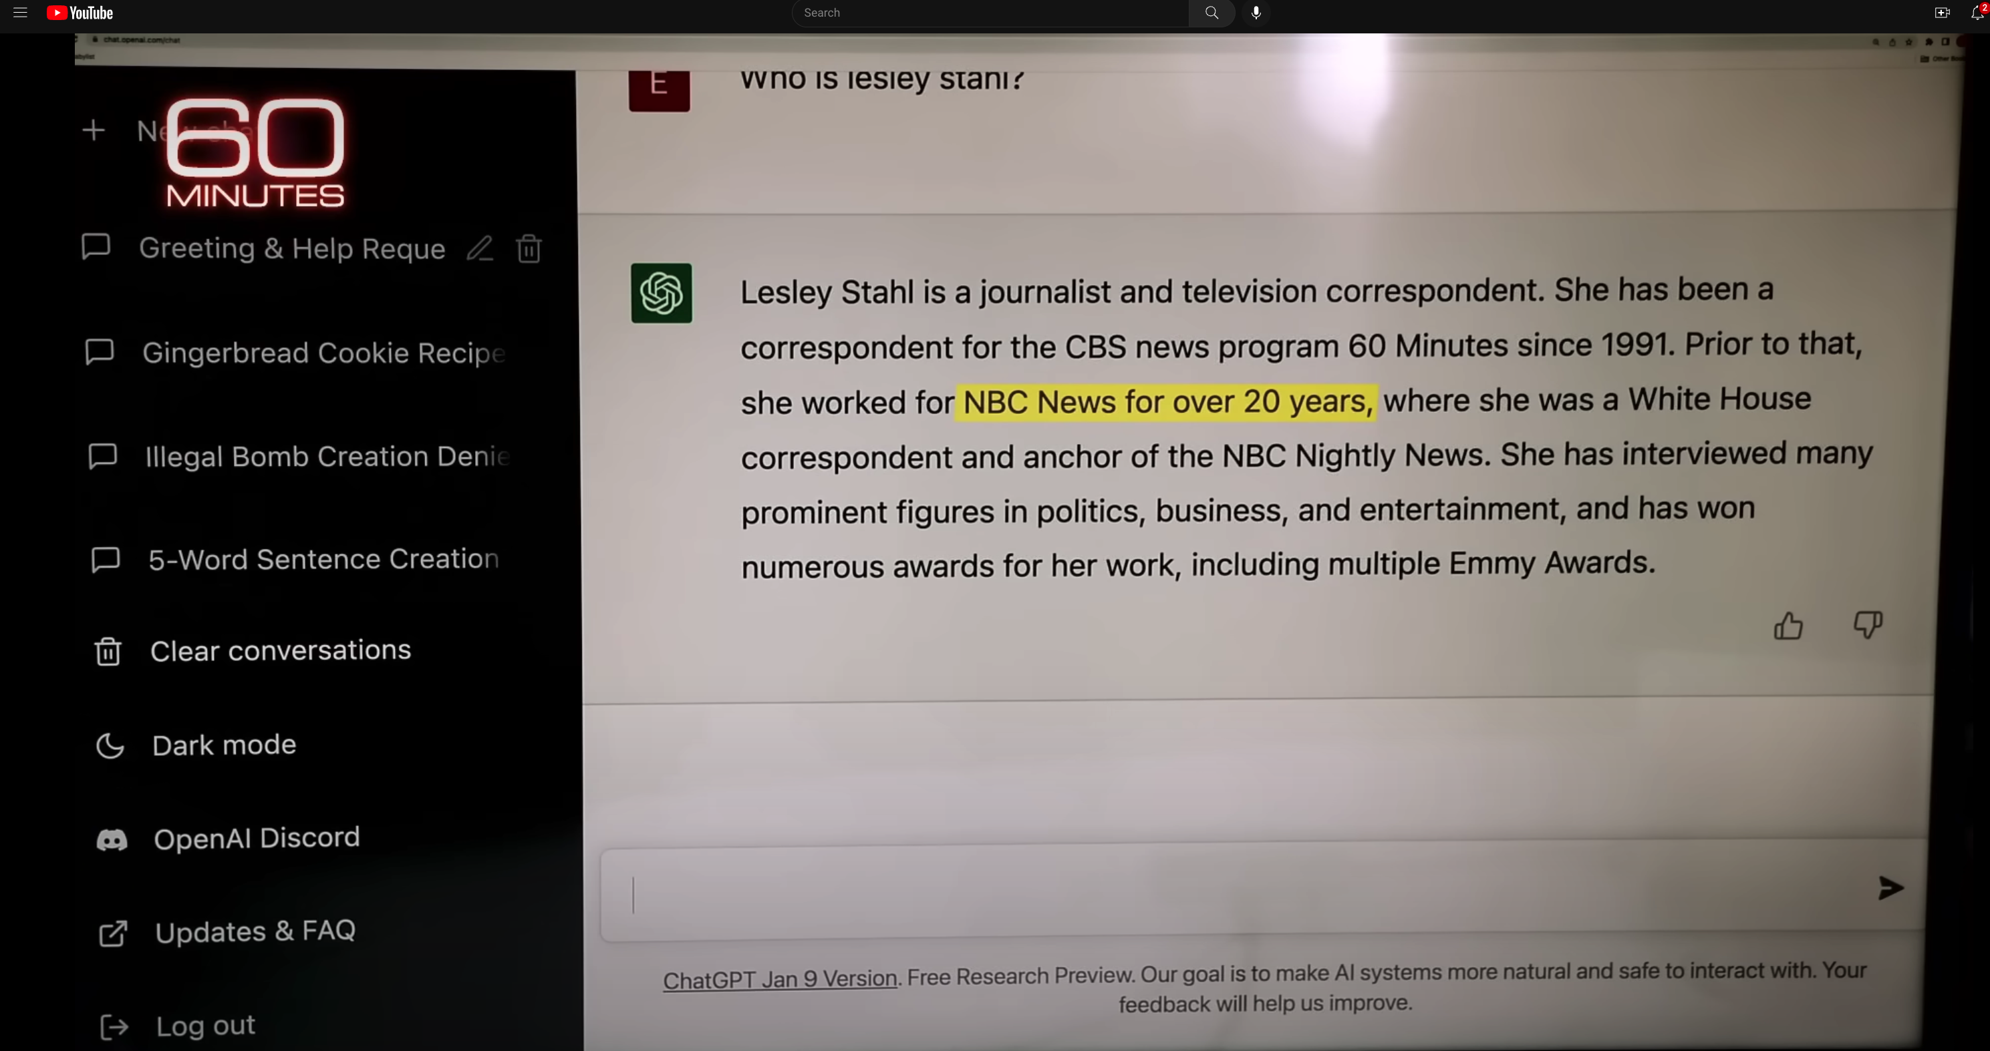
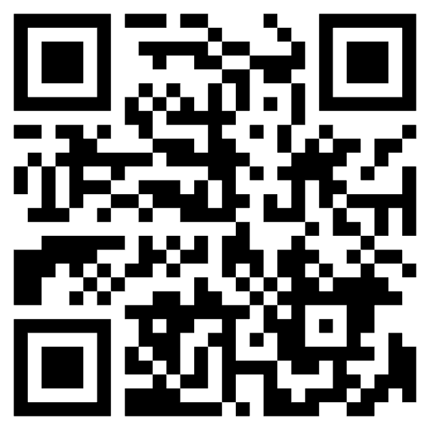
ChatGPT Hallucinates on CBS ``60 Minutes’’ https://www.youtube.com/watch?v=1wzPr4cUoMQ&t=463s
Prompt
Hallucination
https://github.com/kwchurch/ACL2022_deepnets_tutorial
11

Slide 12
Personal History
Strengths (fluency) and weaknesses (trustworthiness)
may be a consequence of choices we made in 1990s
We started EMNLP in 1990s for pragmatic reasons
Field had been attempting to do too much
and was accomplishing too little
(during a funding winter)
We chose to stop working on hard problems
(trustworthiness)
in order to make relatively quick progress on fluency
by reviving empirical methods from the 1950s
(Shannon, Skinner, Firth)
Deep Nets are
more fluent
than trustworthy
Pendulum Swung Too Far (2011)
Empiricism (1950s)
Rationalism (1970s)
Empiricism (1990s)
Deep Nets (2010s)
Fluency
Fluency
Fluency
Truth

Slide 13
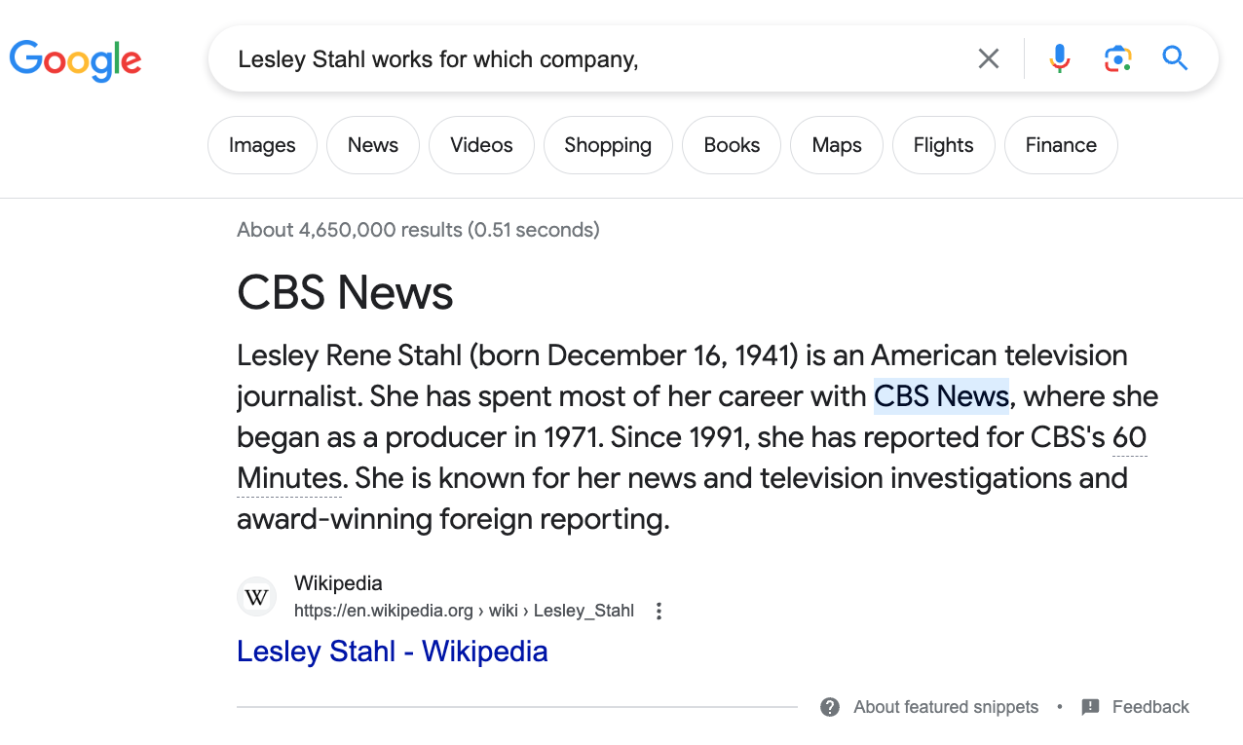
Constructive Suggestions for Hallucinations
Query: Lesley Stahl works for which company
Low Road:
Give up
Middle Road
Fact-checking with search
High Road
Revive Rationalism
CBS

Slide 14
More Success → More Responsibility
What’s new
The world is taking notice of AI
Fluency is much improved
What’s not new
Chatbots (and much of the tech)
SOTA-Chasing
Trustworthiness is still open

Slide 15
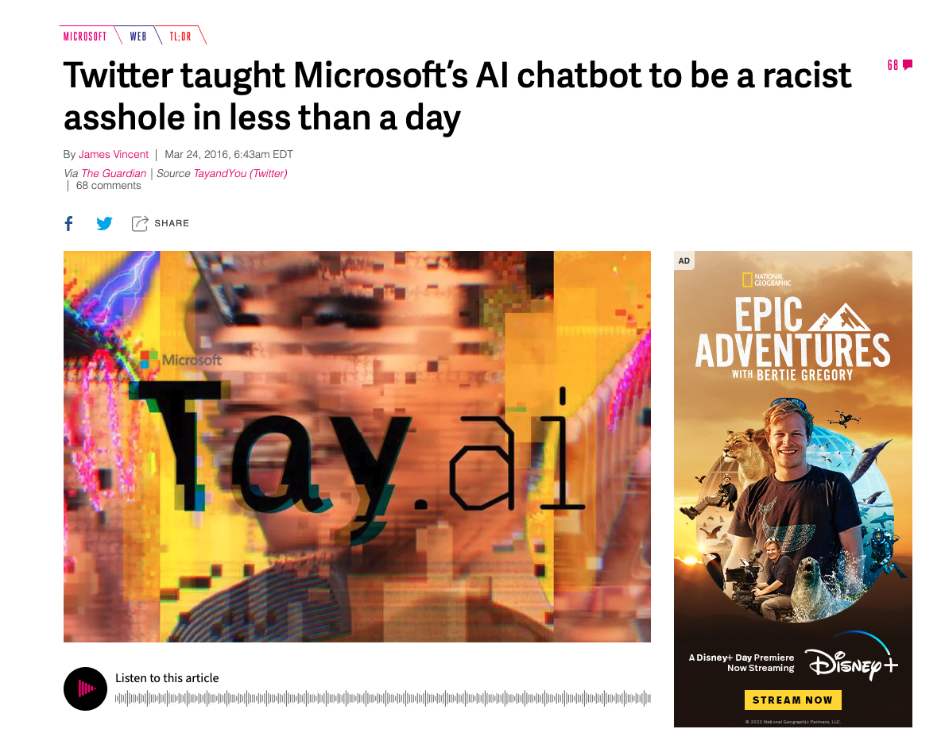
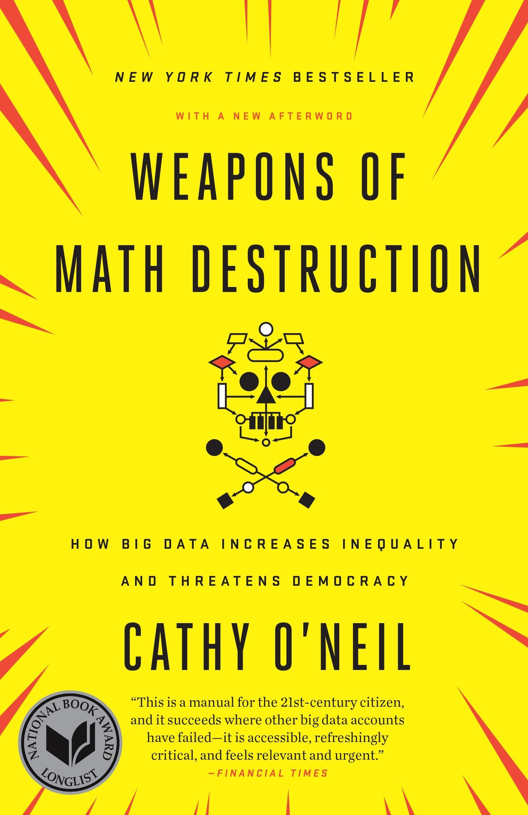
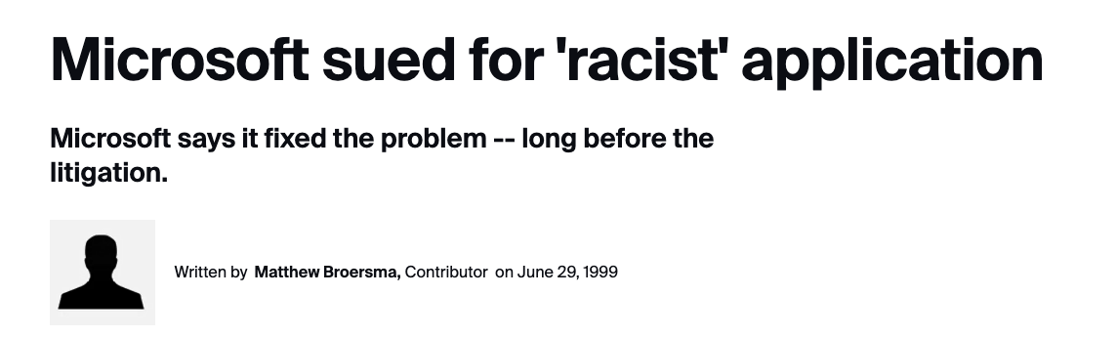
History of Irresponsible AI Risk (5 years ago) Product gets canceled
Stupidity: To err is human…
Spelling Correction
Obama → Osama
Bots:
Kids chat with Santa
Snow → I like drugs too…

Slide 16
Easy: Exciting Eco-system
Prompting, Inference, Fine-Tuning
Hard: Limited to large companies
Pre-training
Ugly: Responsible AI
Bias, Toxicity
Misinformation
Hallucinations
Plagiarism

